Slide 1



Impact of Mental Health on Marriage in the USA (2021/2022)
By Abdelrahman Zaian
MADE 2024/2025

Slide 2
Content
Data overview
Introduction & scope
Data Choice & Pipeline Conditions for Accuracy
Analysis
Set the Hypothesis
Conclusion
Argument
Future work
Q&A
Conduct Analysis
Hypothesis further test

Slide 3
Introduction & Scope
Main Question : Does mental health, specifically mental illness and suicidality, impact marriage rates in different USA states?
Scope of the Question
Category | Factors
Mental Health | 1- Any Mental Illness 2- Serious Mental Illness 3- Received Mental Health Treatment 4- Major Depressive Episode
Suicidality Factors | 1- Had Serious Thoughts of Suicide 2- Made Any Suicide Plans 3- Attempted Suicide

Slide 4
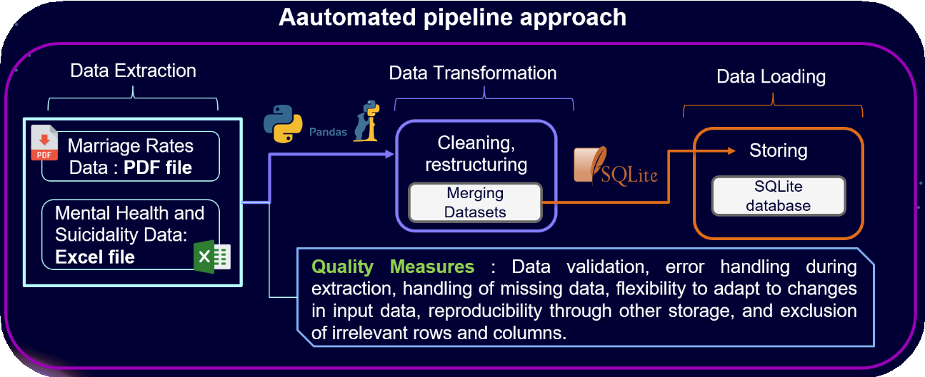
Data Choice & Pipeline
Dataset 1: Marriage Rates by State (2019-2022) | Dataset 2: Mental Illness and Suicidality (2021-2022)
National Center for Health Statistics This dataset shows the number of marriages per 1,000 people in each U.S. state for 2021/2022 | Trusted source with Accuracy National Survey on Drug Use and Health with - Confidence Intervals 95% Age Groups: Includes specific data for 12-17, 18-25, 26+, and 18+.

Slide 5
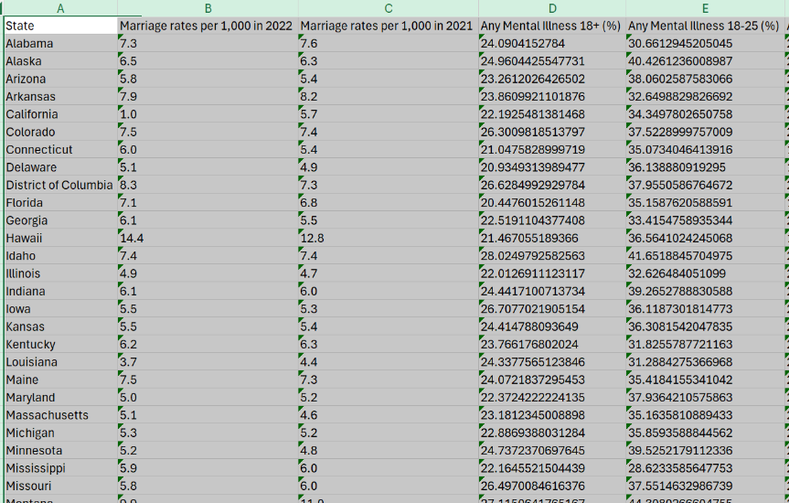
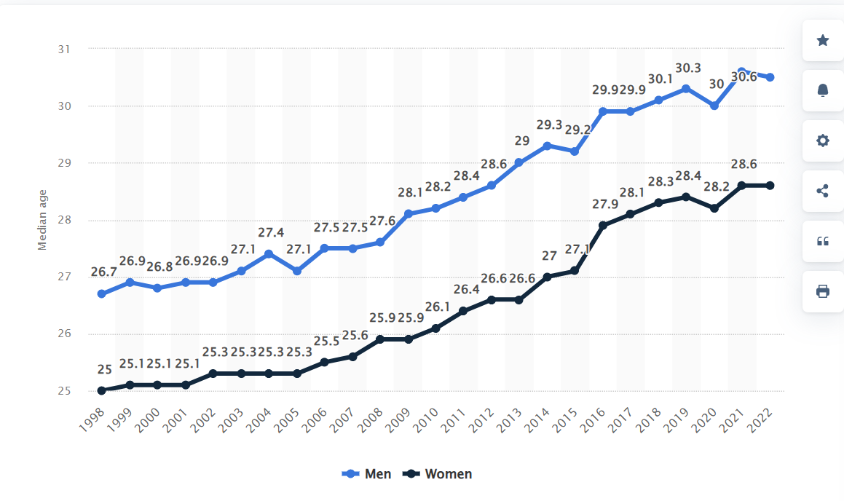
Conditions for Accurate Analysis
While thinking what is the best way to answer the question and to create a proper Hypothesis I came a cross several obstacles
I have originally 4 age groups as discussed earlier
Only 2 years of data which is not enough to create relation between the change of marriage rates compared to health factor
Marriage is suspected to other factors, such as socioeconomic conditions, cultural norms and religion and these are highly diverse in a migrant country like USA
Health factors were taken in 2021 and 2022 due to sample size
Solutions
Sol 1 : As in 2021 and 2022 is our scope I did further research and found out the following median age for men and women is 30 and 28 Hence I focus on the Age group 26+ (Health factors)
Sol 2,3 : To Avoid Noise its logical to understand that every state has different constitution laws as well as society so instead of the focusing on the year to reach correlation we will analyse based on each state
Sol 4 : Get the avg marriage rate 2021 and 2022
Estimated median age in USA first wedding
from 1998 to 2022, by sex

Slide 6
Analysis - Set the Hypothesis
(𝐻0): There is no significant correlation between marriage rates and mental health metrics or Suicidality Factors . Any observed correlation is due to random chance.
(𝐻1​):There is correlation between marriage rates and mental health metrics or Suicidality Factors. this relationship is unlikely to be due to random chance.

Slide 7

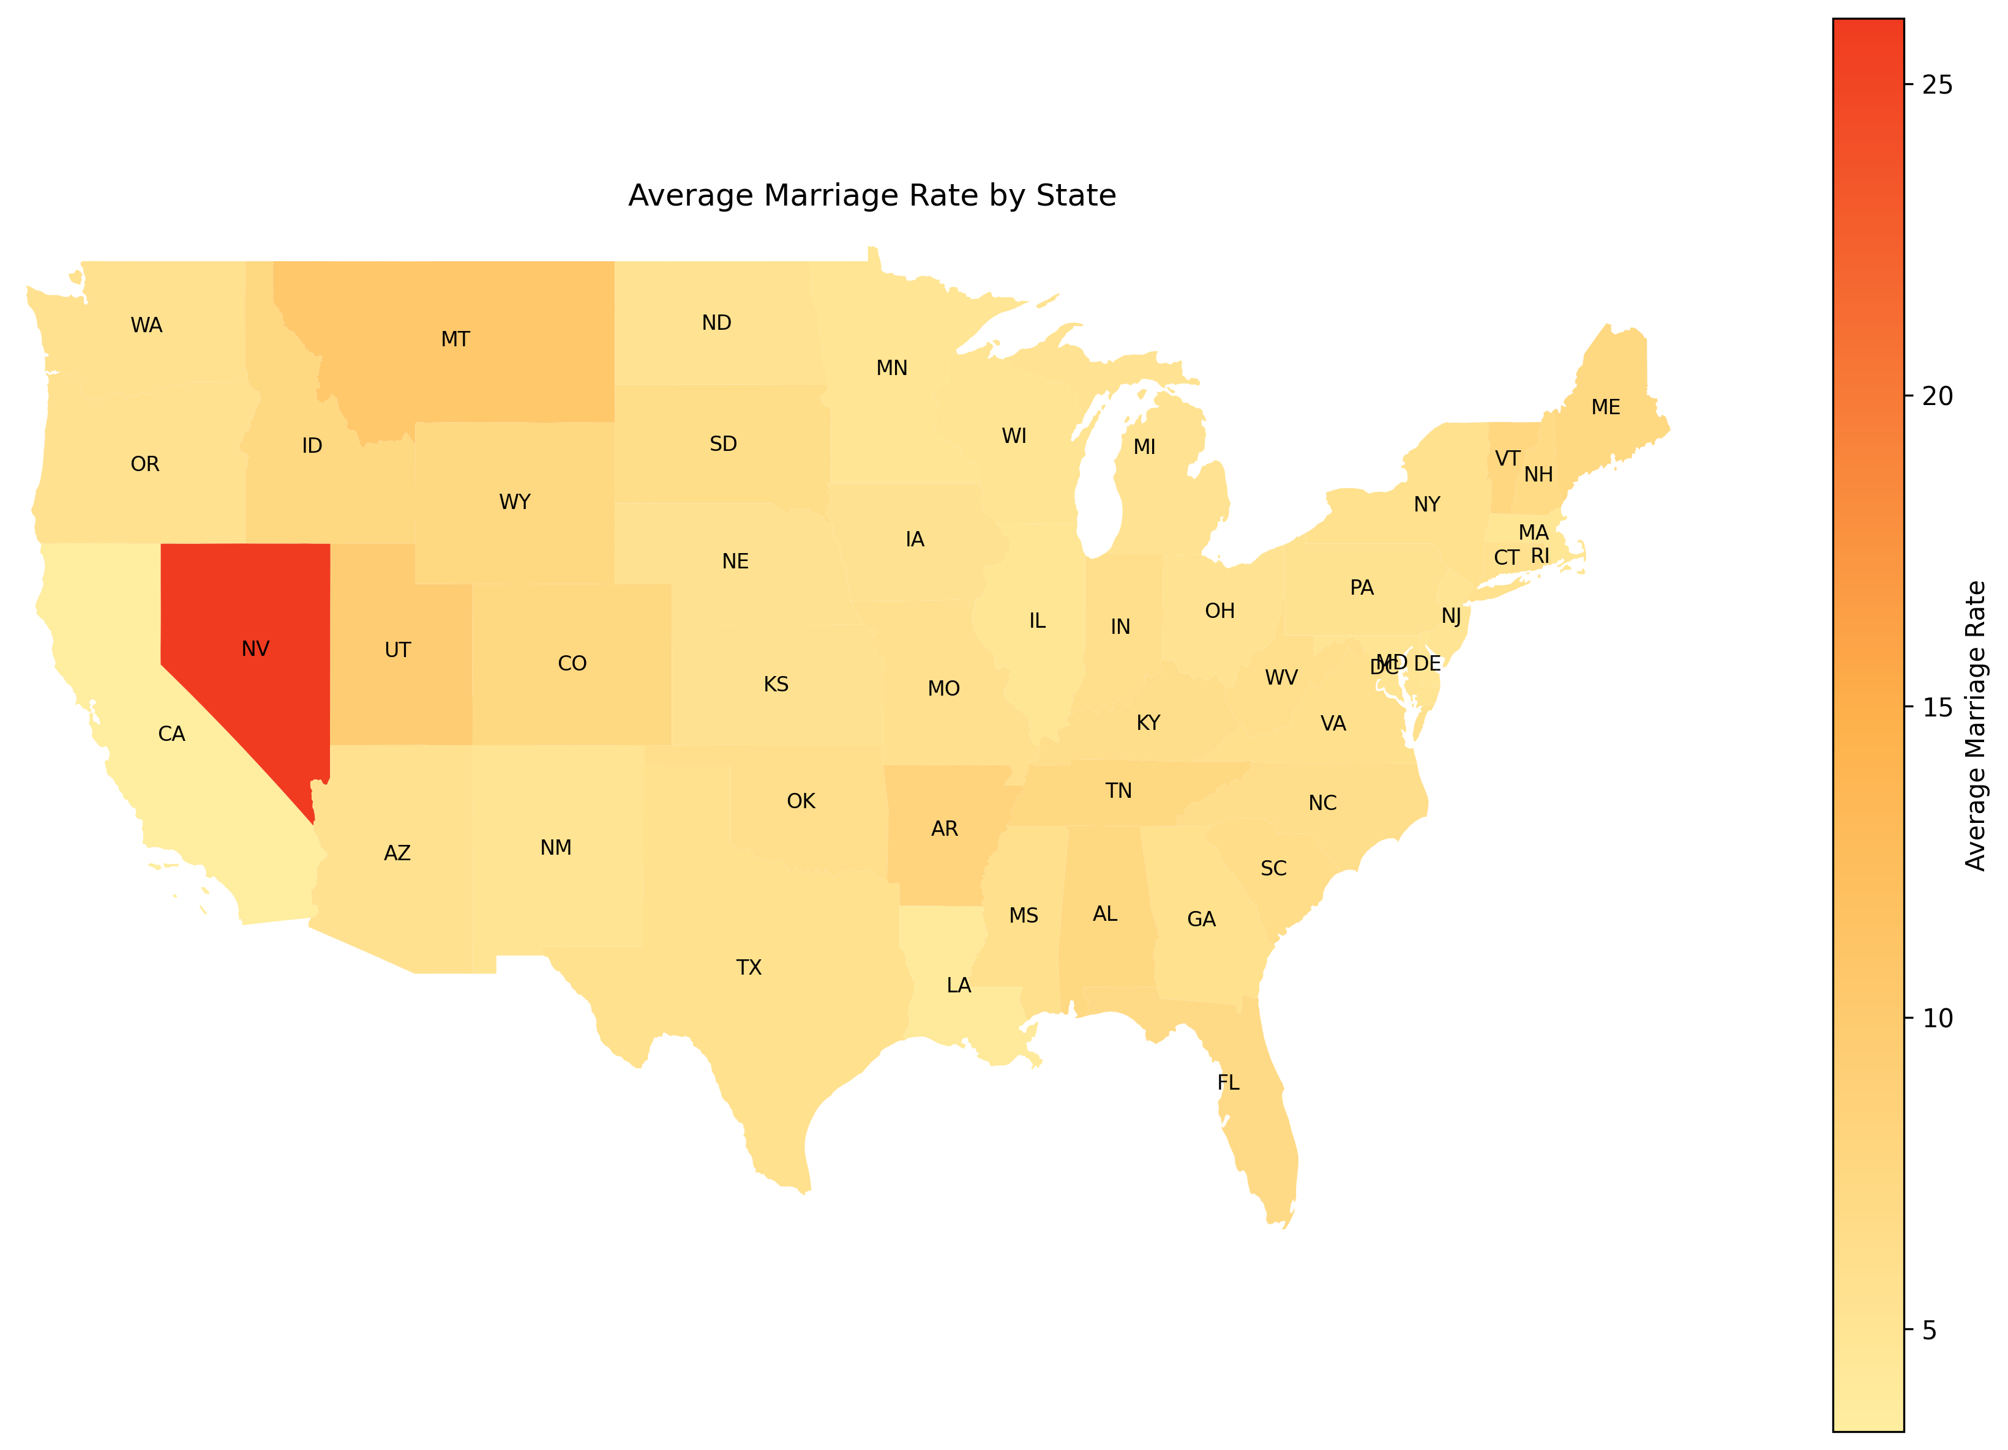
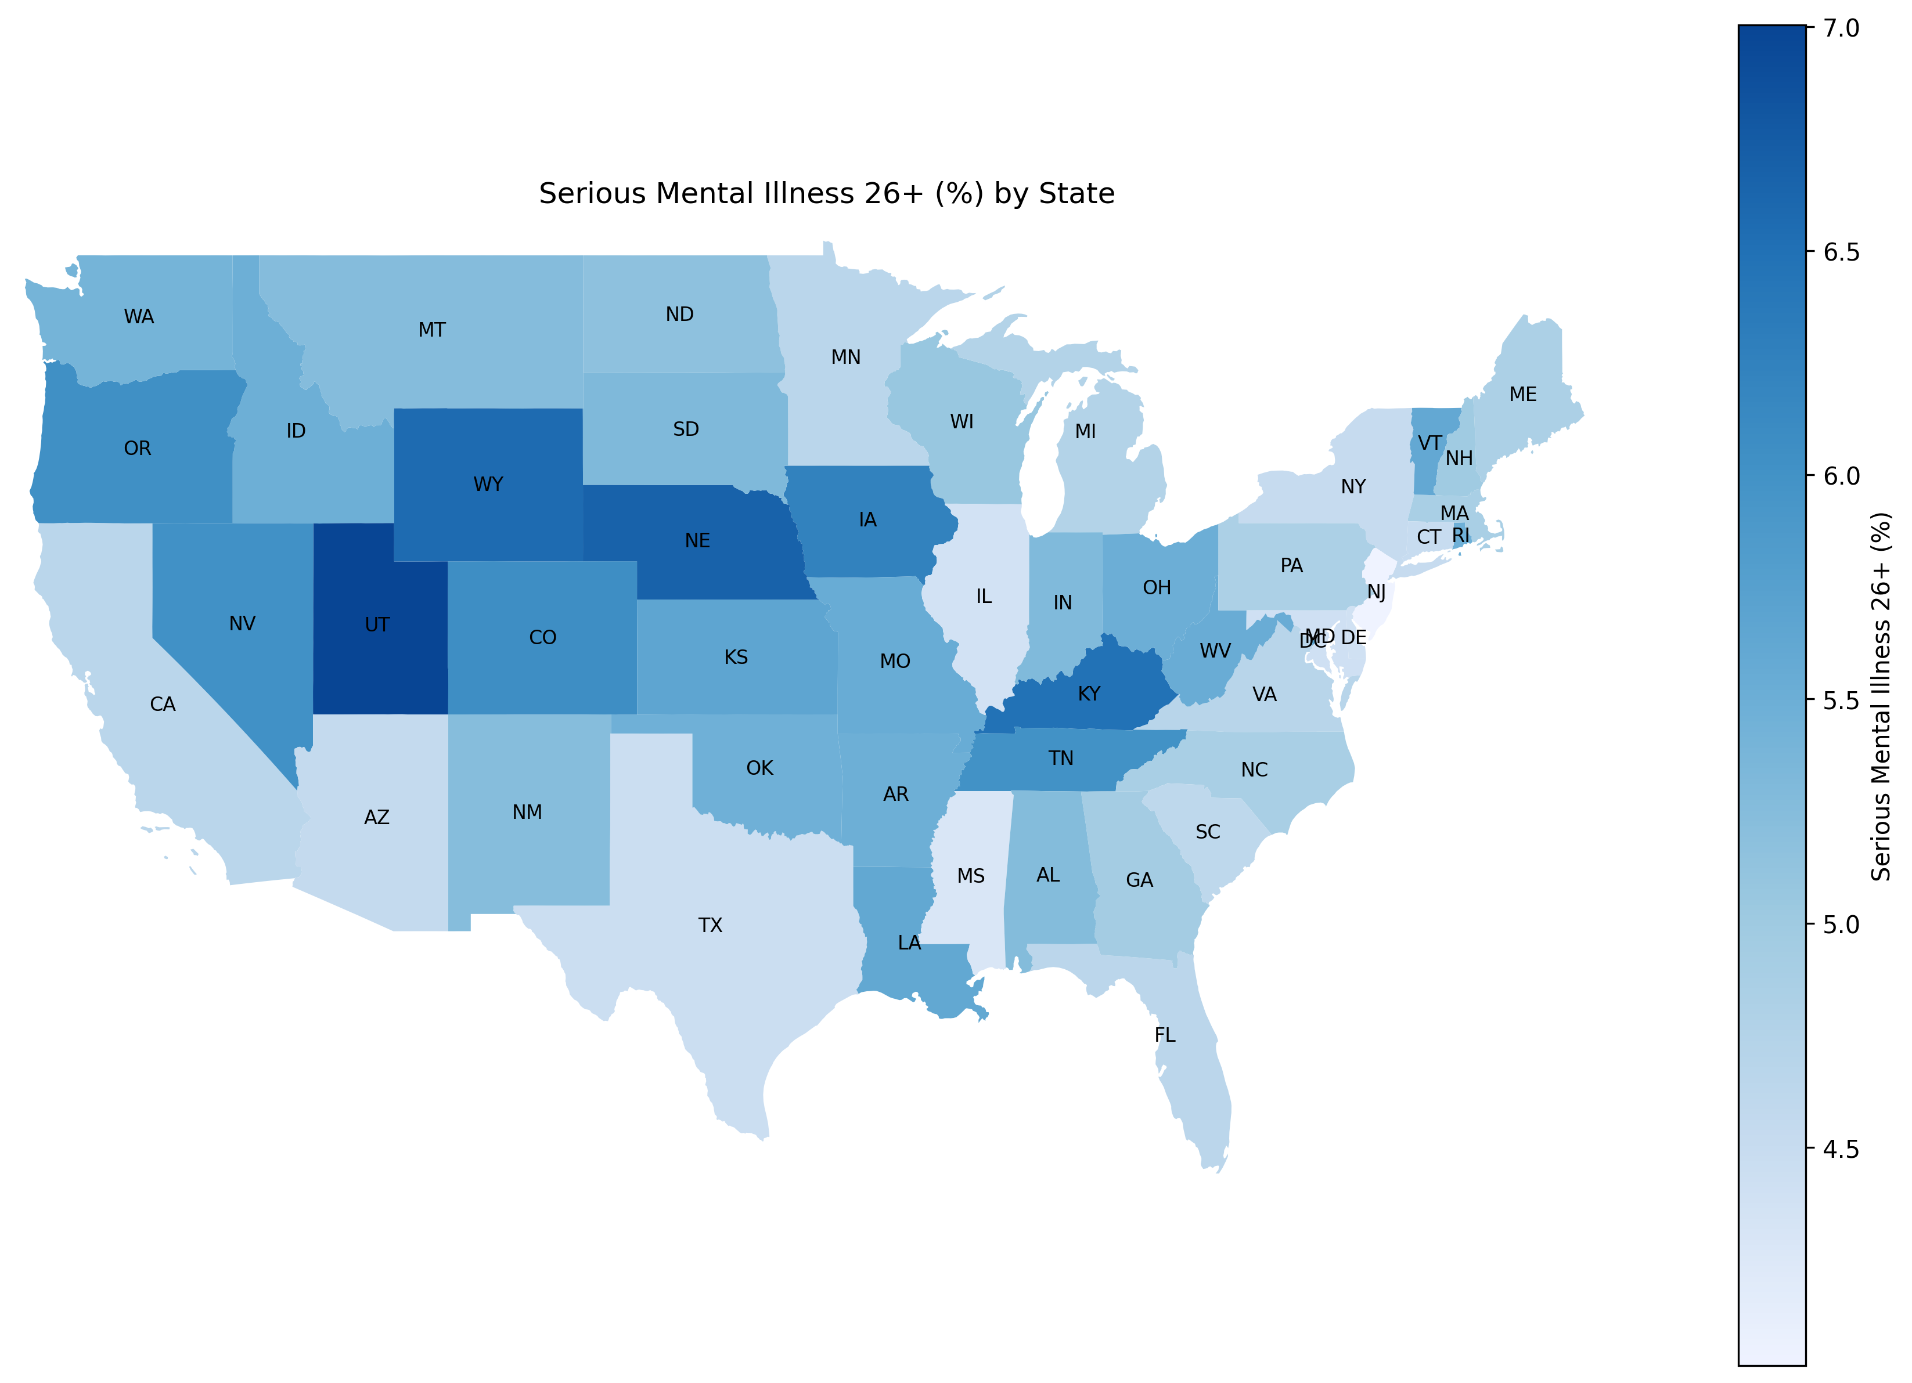
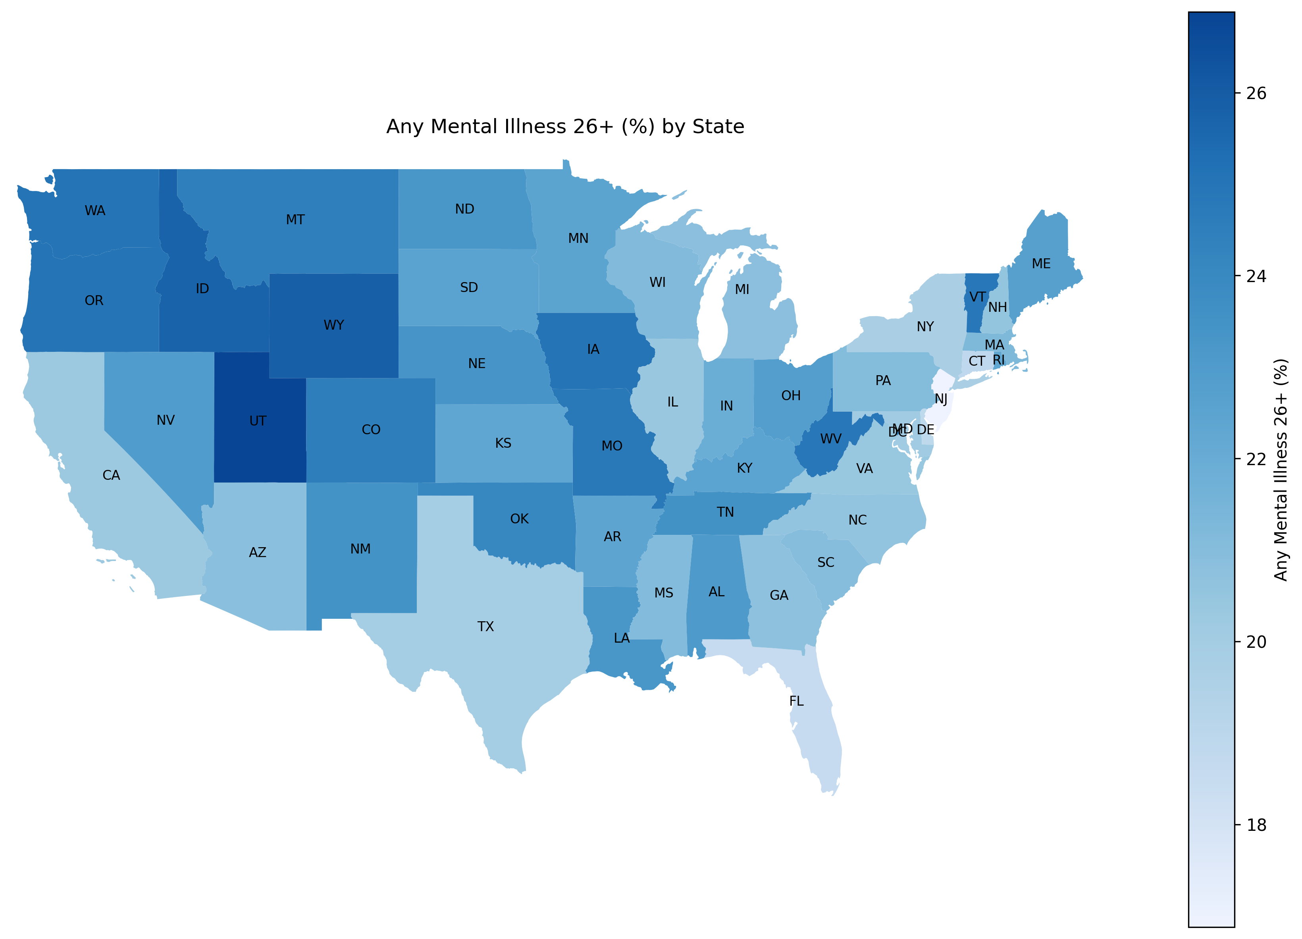
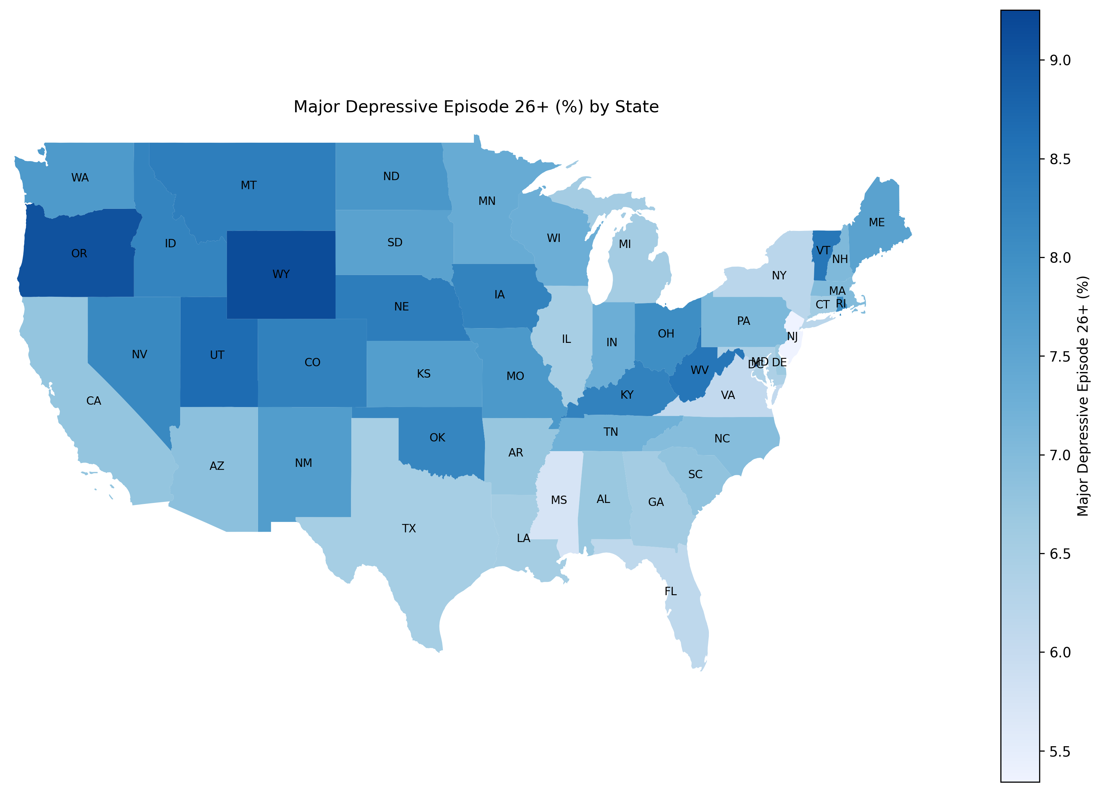
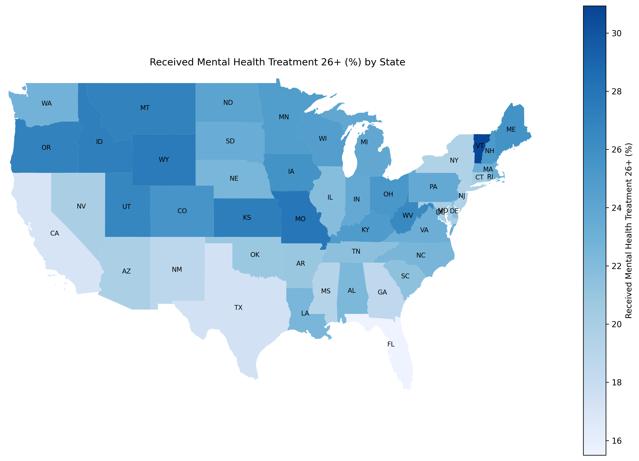
Analysis – Geo visualization of Mental Health

Slide 8
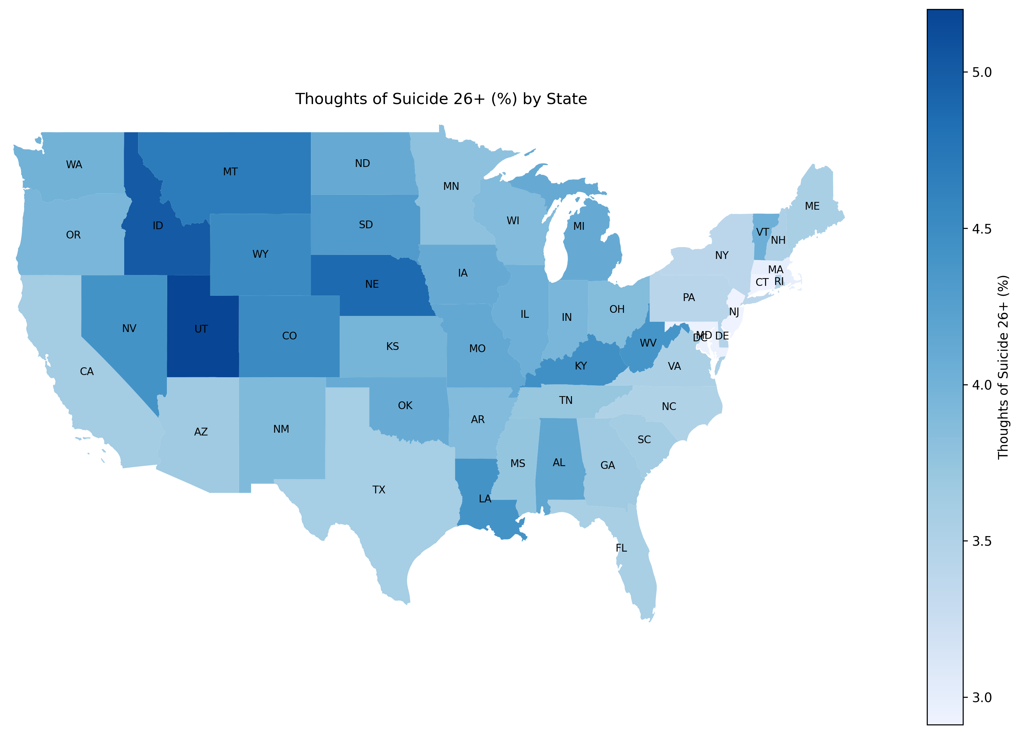
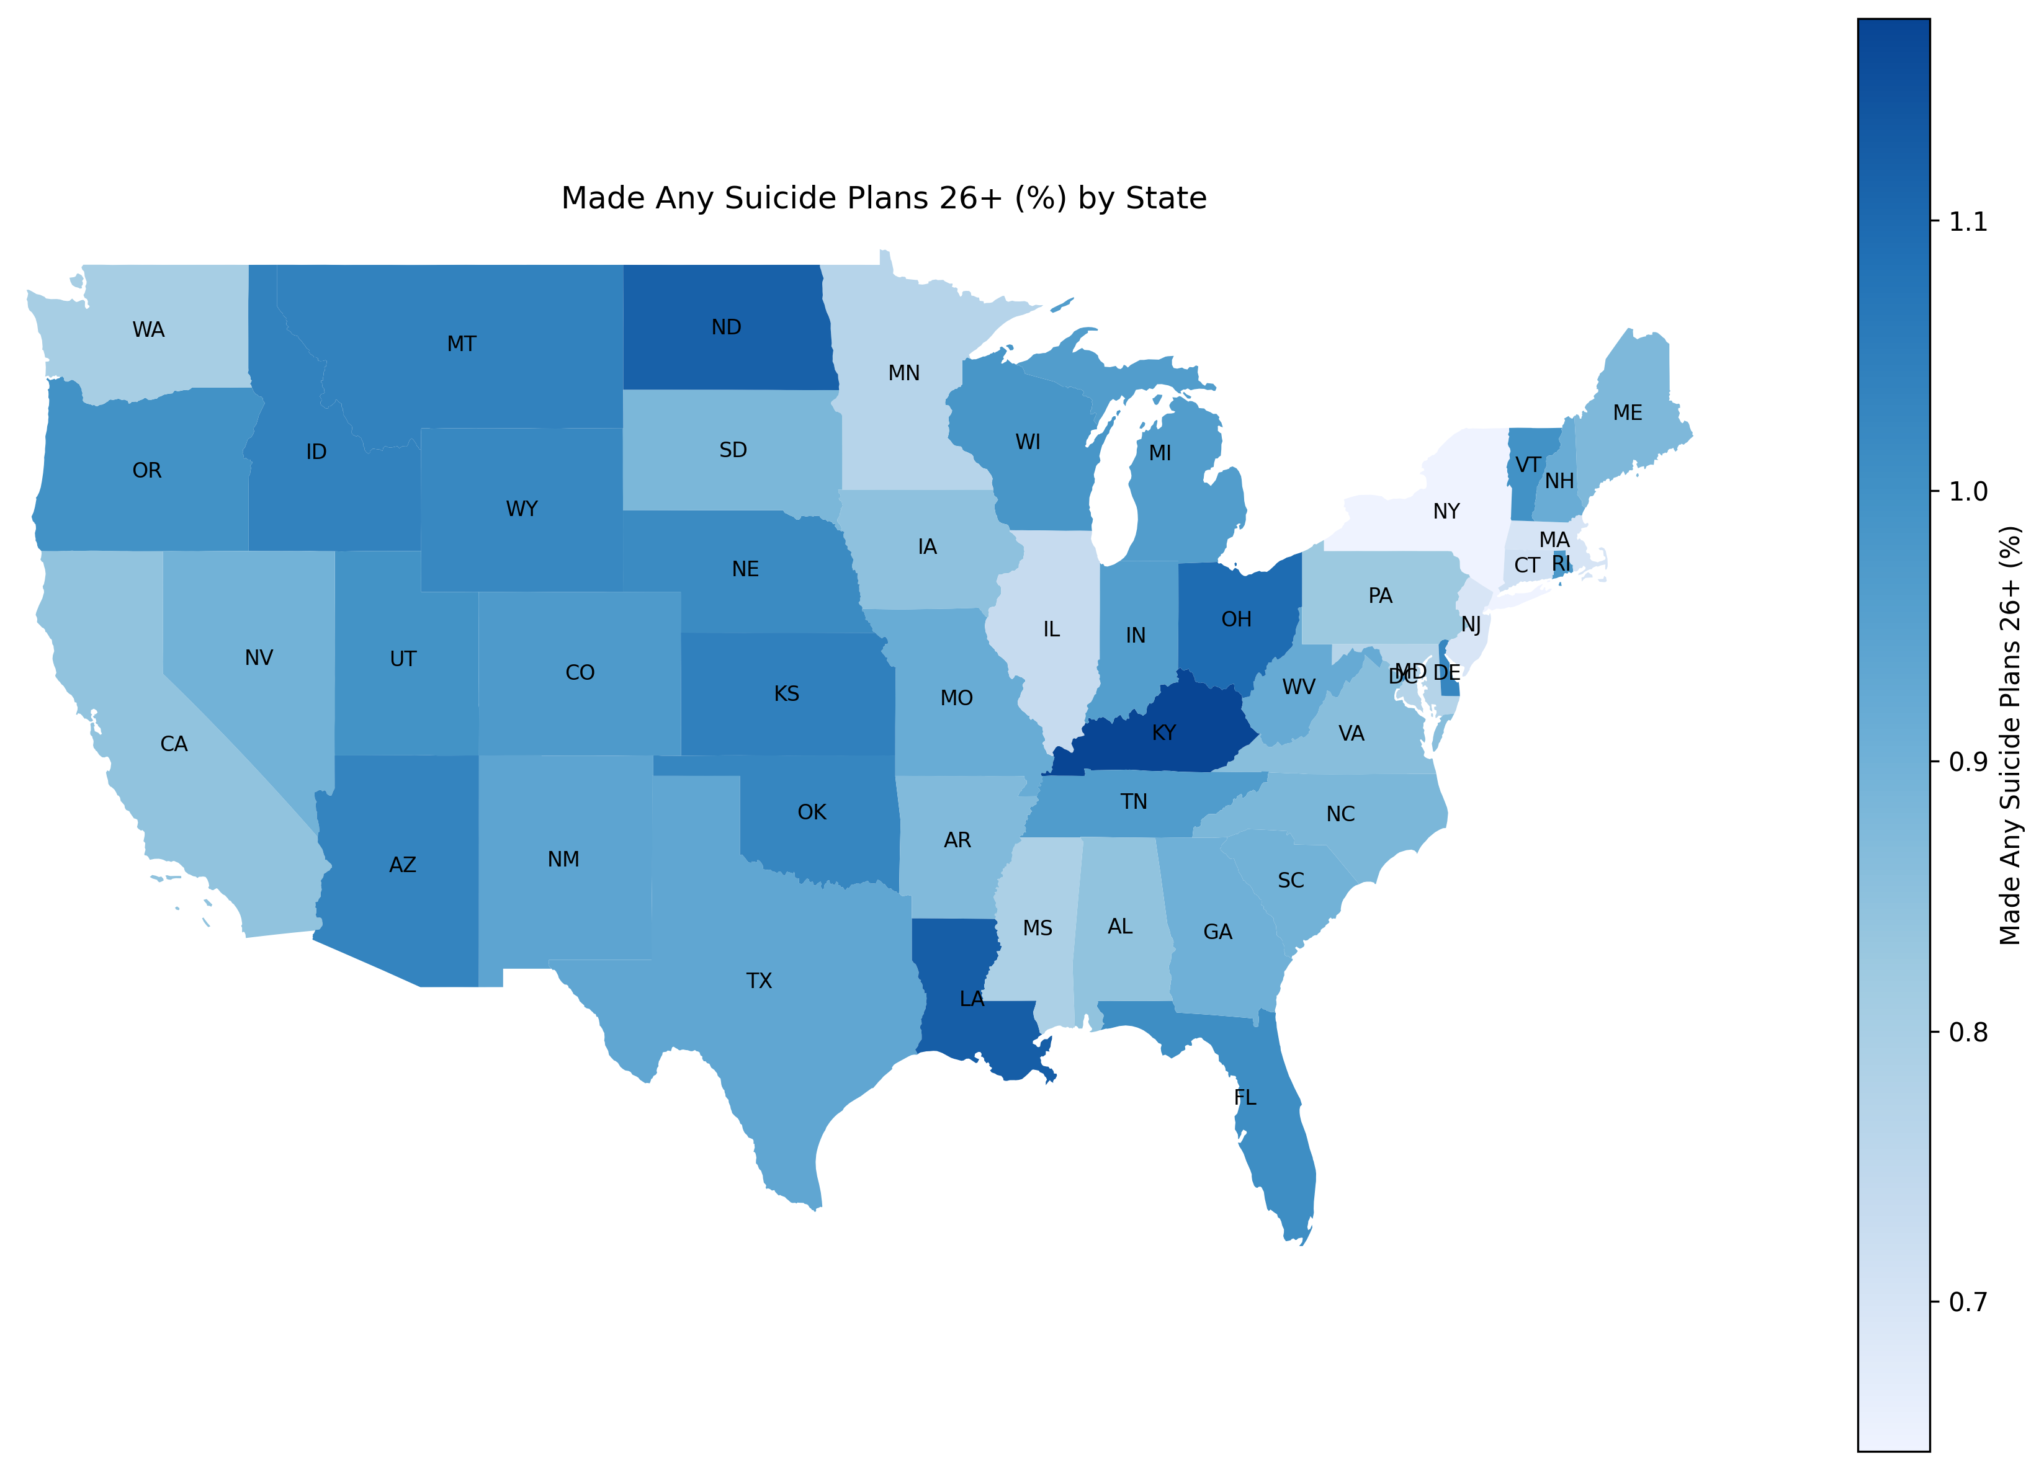
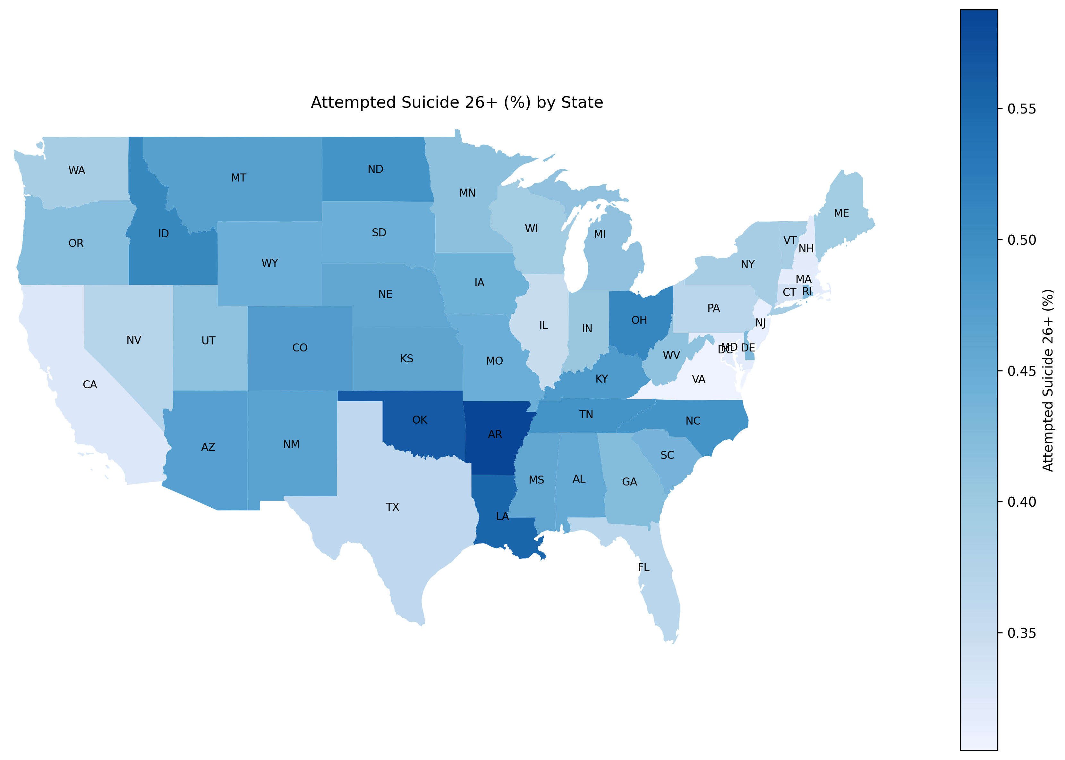
Analysis – Geo visualization of Suicidality Factors

Slide 9
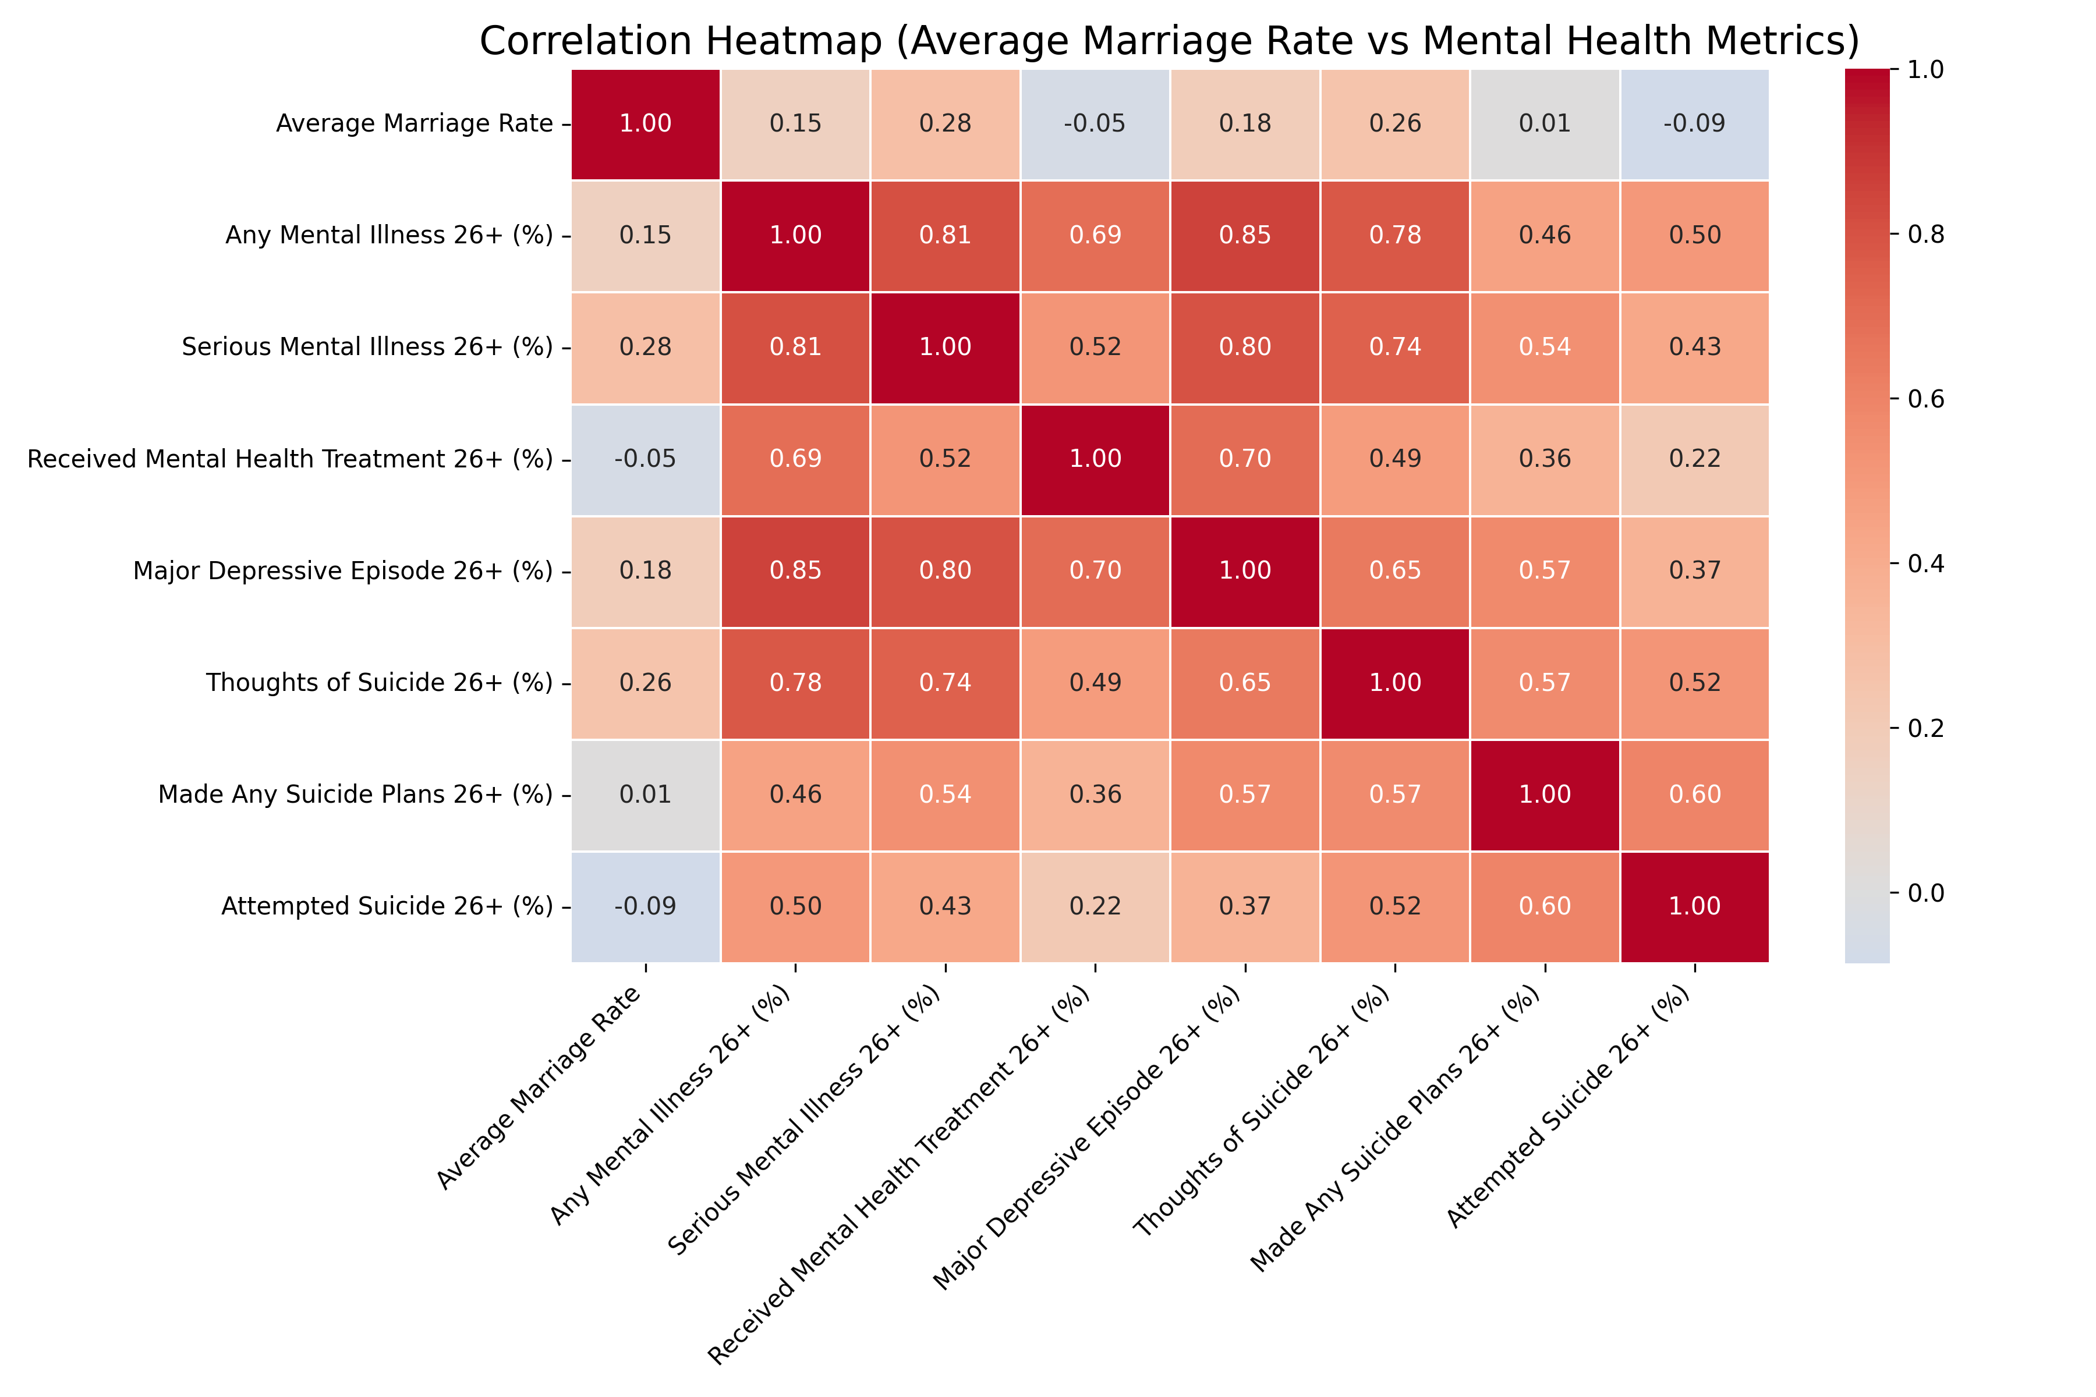
Analysis – Correlation matrix
Further Analysis needed
More detailed, state-specific correlations and P-values.

Slide 10
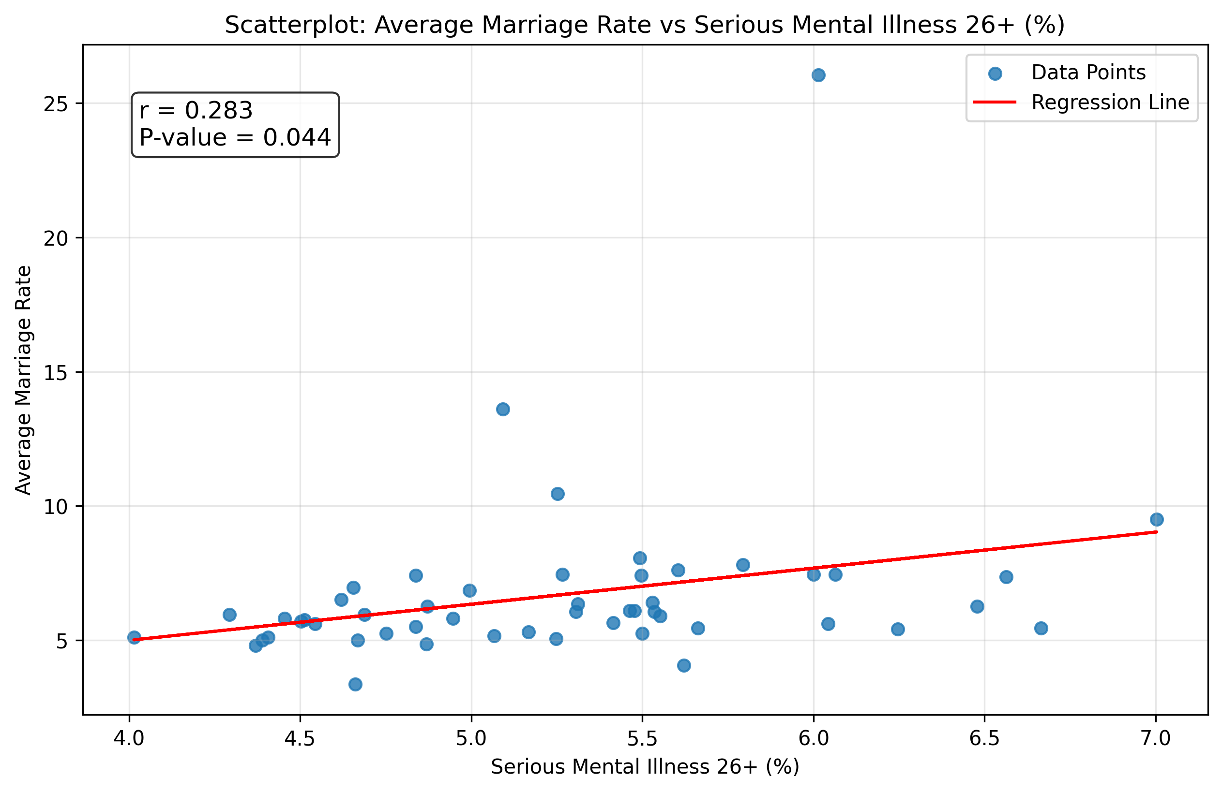
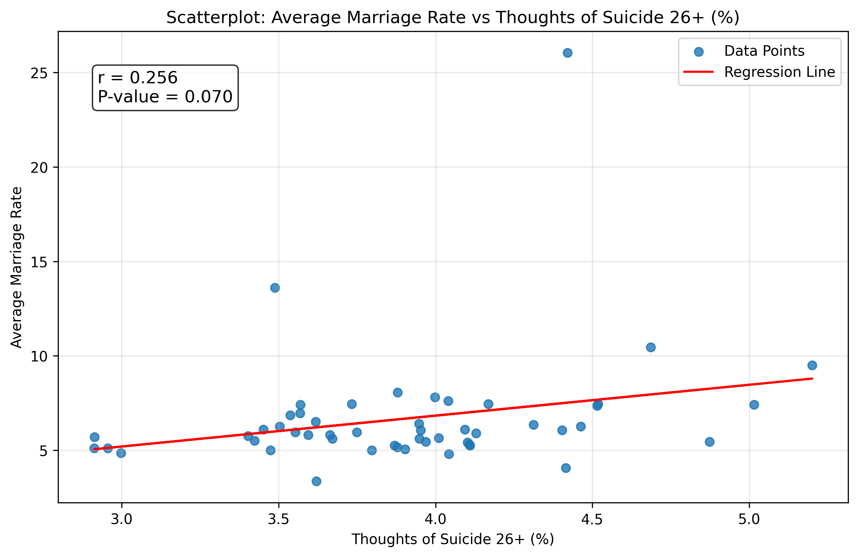
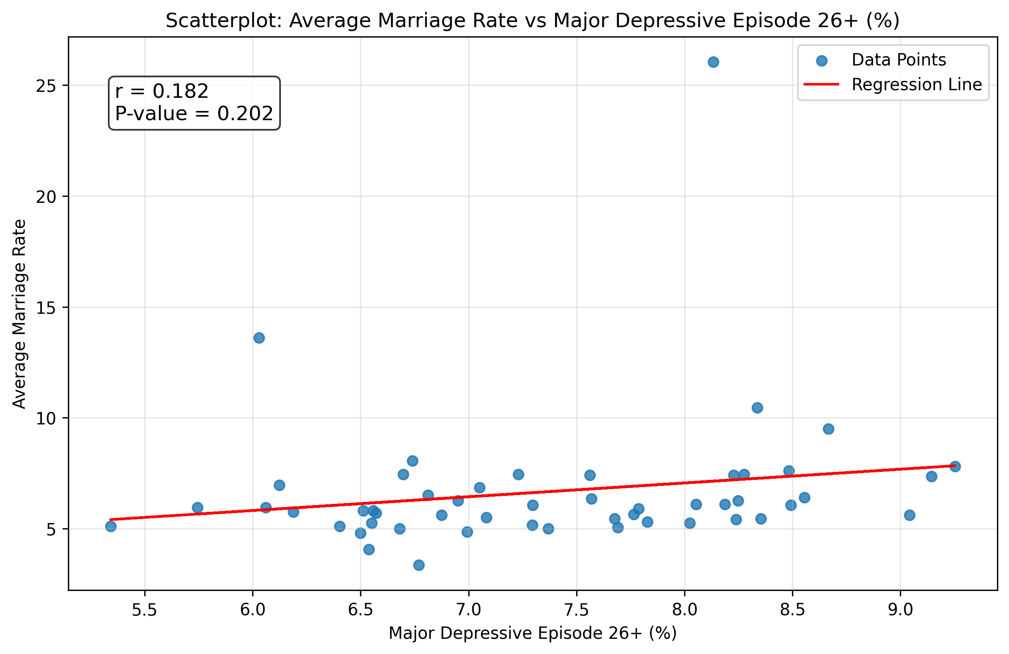
Analysis – Top 3 Strongest Correlations:
Mental Health Metric: Serious Mental Illness 26+ (%)
Correlation: 0.283
P-value: 0.044
-----------------------------------------------------------------------------Mental Health Metric: Thoughts of Suicide 26+ (%)
Correlation: 0.256
P-value: 0.070
-----------------------------------------------------------------------------Mental Health Metric: Major Depressive Episode 26+ (%)
Correlation: 0.182
P-value: 0.202
-----------------------------------------------------------------------------
Pearson correlation coefficient (r)
Calculate the Test Statistic (t)
Degrees of Freedom (df)
Compare t to a t-Distribution

Slide 11
Analysis –Strongest Correlations (linear regression):
Metric | Coefficient | Intercept | R-squared | P-value
Serious Mental Illness 26+ (%) | 1.3442 | -0.3886 | 0.0799 | 0.0445
Thoughts of Suicide 26+ (%) | 1.6361 | 0.2805 | 0.0655 | 0.0697
Major Depressive Episode 26+ (%) | 0.6216 | 2.0798 | 0.0330 | 0.2018
Serious Mental Illness 26+ (%) has the strongest and statistically significant relationship with the Average Marriage Rate, though its explanatory power (R-squared) is still low at 8%. For every 1% increase in the rate of Serious Mental Illness 26+, the Average Marriage Rate is predicted to increase by 1.34 person per 1000.
Thoughts of Suicide 26+ (%) shows a marginally significant relationship with marriage rates, but its explanatory power is even weaker (R-squared of 6.6%).
Major Depressive Episode 26+ (%) has the weakest relationship, both in terms of explanatory power (R-squared of 3.3%) and weakly significant.

Slide 12
Conclusion – Argument
The result is quite shocking for me to be honest from my life experience main reason it’s a positive correlation
If mental health issues are severe, they could create barriers to forming stable relationships
BUT
R-squared values are very low mental health is not a significant determinant of marriage rates. (small variability)
Correlation ≠ Causation: The relationship between mental illness and marriage rates may not imply causation
I am in Favor of Null Hypothesis
(𝐻0): There is no significant correlation between marriage rates and mental health metrics or Suicidality Factors . Any observed correlation is due to random chance.
Hence, I will take it with a grain of salt Moderate positive correlation between 'Serious Mental Illness 26+ (%)' and marriage rates and adjust the conclusion to be
There is no significant correlation between marriage rates and mental health metrics or Suicidality Factors . Any observed correlation is due to random chance. Except for a chance that 'Serious Mental Illness 26+ (%)’ Factor show some potential and need further study

Slide 13
Conclusion – Future Work
Longitudinal Analysis: I will observe changes in marriage rates and mental health factors over time not just by State-Level Data

Slide 14
THANK YOU Q&A

